Slide 1
Relative Analgesic Effectiveness Of Pharmacological Interventions In Knee Osteoarthritis: A Component Network Meta-Analysis
Bawan Ahmed
University of Greenwich
8th November 2024

Slide 2

Importance of Evidence
Is medicine (A) effective compared with placebo or another intervention (B)?
(A) has been compared with a placebo in 10 RCTs. Is it more effective than a placebo?
Are (A, B, C, D and Placebo), in general, effective compared with each other or placebo?
Are pharmacological interventions containing specific pairs (A+B) effective, all other things being equal? OR
Can I predict the extra benefit/harm of adding medicine (A) to the current treatment with (B)?

Slide 3

The problem with Medicine and Medical Sciences
“Half of what you'll learn in medical school will be shown to be either dead wrong or out of date within five years of your graduation”-David Sackett
The problem is we do not know which half?!

Slide 4
Another problem!
Knowledge and Wisdom
MEDLINE indexers index more than 850,000 articles each year for inclusion into Pubmed/MEDLINE, the largest bibliographic database in the world. (Medline, 2024)
Q. How to keep up with relevant literature and provide high quality care?
Physicians trained in epidemiology would take an estimated 627.5 hours per month to evaluate relevant literature (Alper, 2004)
Clinical Evidence Synthesis using gold standards.
EMB relies heavily on such standards

Slide 5
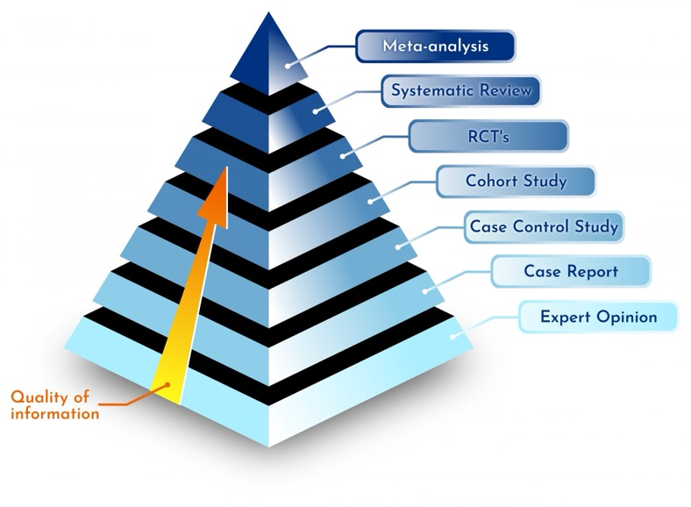
Levels of Research-Evidence
NMA

Slide 6
Meta and Network-Meta evidence synthesis?
RCTs
Systematic Reviews (SR) and Traditional Meta-Analysis (2 interventions)
Network Neta-Analysis for multiple interventions (an extension of MA, at the forefront of evidence synthesis), Component NMA is an extension of NMA to estimate the relative effectiveness of multi-component interventions.
To assess clinical effectiveness, evidence from RCTs is typically used.
If > 2 RCTs available: relative treatment effects estimated in individual trials are pooled using methods that preserve within-trial randomisation. However,
For most diseases, there are more than 2 interventions. In such cases:
Multiple pairwise MA are required.
Clinical decisions involving > 20 interventions are not uncommon.
To make a decision, the number of pairwise comparisons between 3 interventions is 3, with 5 interventions it is 10, with 20 interventions it is 190!
(Dias and Cladwell, 2018)

Slide 7
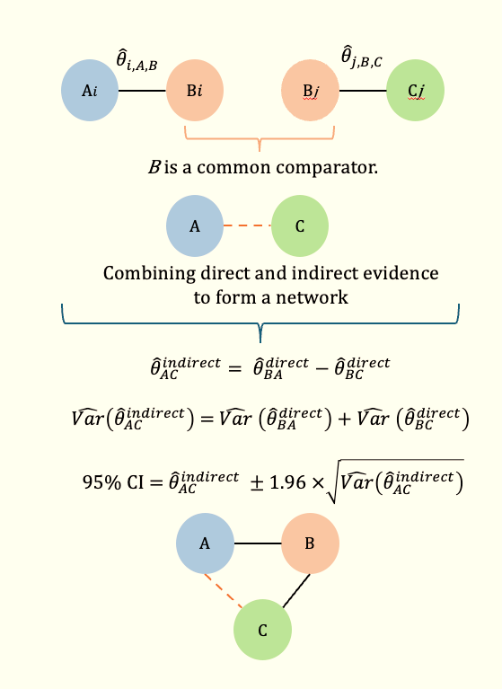
A
B
C
D
B
C
A
B
C
D
B
C
A
B
C
D
A
B
C
D
A
B
C
D
Two Key Assumptions:
Transitivity
Inconsistency

Slide 8
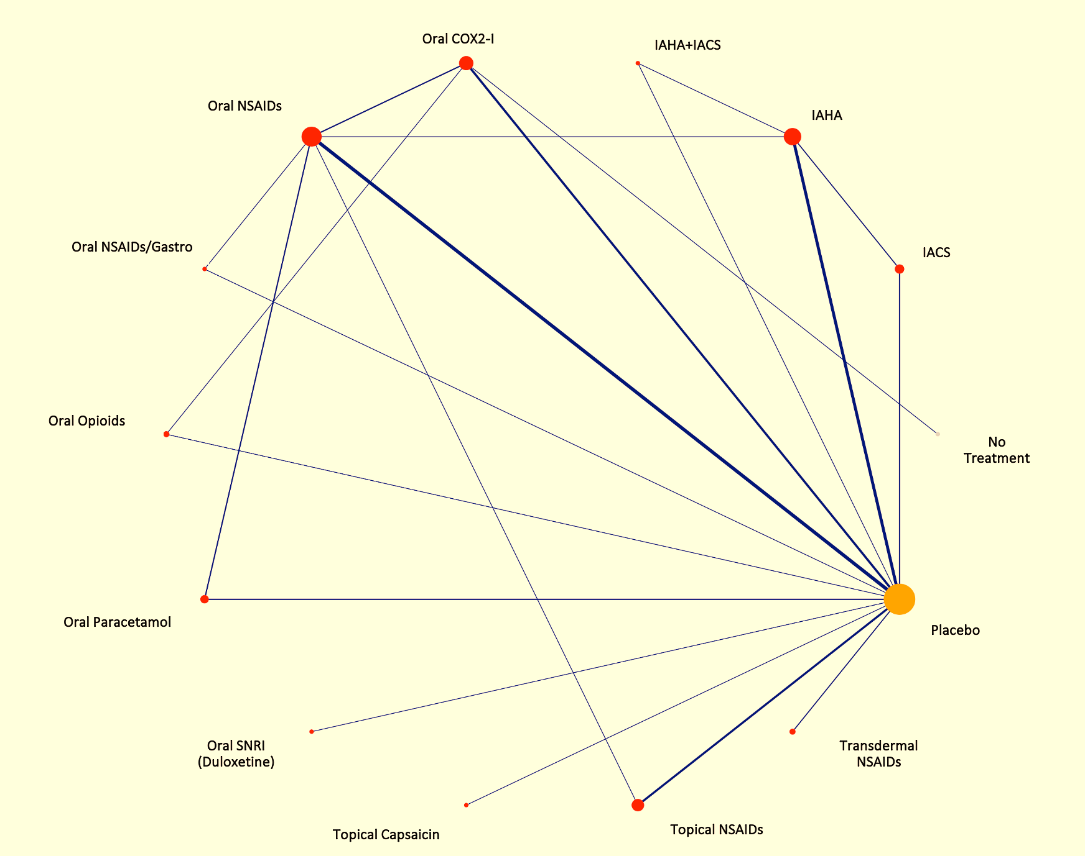
Fig.1. Experimental network of interventions

Slide 9
Disease Area of focus:
Knee Osteoarthritis

Slide 10


In 1999, the Secretary-General of the United Nations, Kofi Annan, signed a declaration to launch the Bone and Joint Decade 2000–2010 for treating and preventing musculoskeletal disorders.
We have not cured most MSK diseases.
In 2020, the WHO, in its action plan report, declared the period from 2021 to 2030 as the decade of healthy ageing, emphasising the importance of tackling conditions like OA.
Arthritis is a single disease with a spectrum of more than 100 types. Osteoarthritis (OA) is by far the most common type of arthritis.
OA is a chronic degenerative disease of moveable joints, and it is associated with pain, disability, and socioeconomic burden, particularly when big joints such as the knee joints are affected.
(Litwic et al., 2013; Spitaels et al., 2020; Steinmetz et al., 2023)

Slide 11
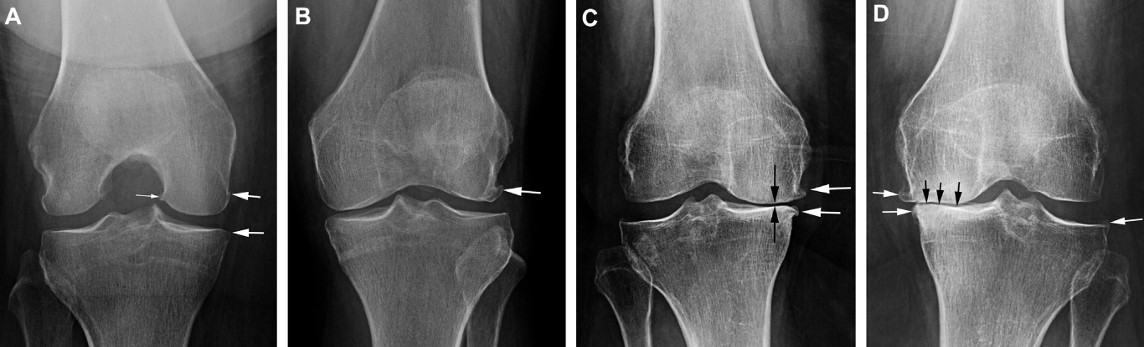
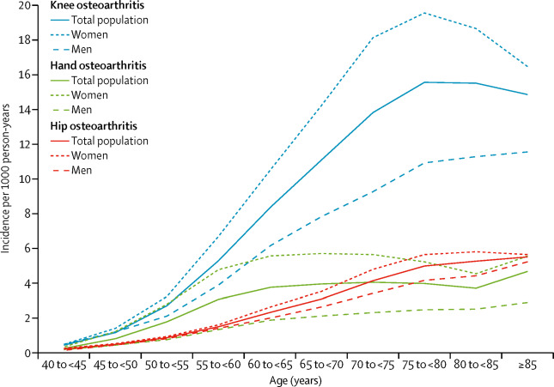
Among all OA conditions, knee joint OA is the most prevalent and substantially burdens public health, accounting for about 83% of the overall OA burden.
In the UK alone, 10 million individuals (1 in 6) have OA; an estimated 50% have Knee OA (Versus Arthritis, 2023).
(Katz et al., 2021)
Core symptoms:
Pain
Joint stiffness
functional disability
Currently, there is no known cure for OA
Surgery remains the only treatment option, BUT:
Patients typically undergo an average of 13.3 years of non-surgical management of Knee OA before becoming eligible candidates for surgery (Losina et al., 2015)
Algorithms and models of care are available, but there are significant EBM gaps in osteoarthritis care.
Fig.2 Age and gender-specific incidents of OA (Hunter & Bierma-Zeinstra, 2019)

Slide 12
Ahmed et al. (n.d.) manuscript in preparation
Interventions | Guidelines recommendations for management of Knee Osteoarthritis
Pharmacological | NICE | ACR | OARSI | AAOS | ESCEO
Paracetamol
Oral NSAIDs
Topical NSAIDs
Opioids
Duloxetine
IAHA
IACS
Topical Capsaicin
Non-Pharmacological | NICE | ACR | OARSI | AAOS | ESCEO
Education
Exercise
TENS
Ultrasound
Electromagnetic
Thermal therapies
Interpretation
 | Recommended (Use)
 | Not recommended (Do not use)
 | Consider, depending on the circumstances
 | May be consider, depending on the circumstances
 | Inconclusive (No recommendations issued)

Slide 13
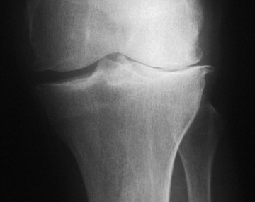
What is REIKO?
Relative Effectiveness of Interventions for Knee Osteoarthritis.
SR
NMA
CNMA

Slide 14
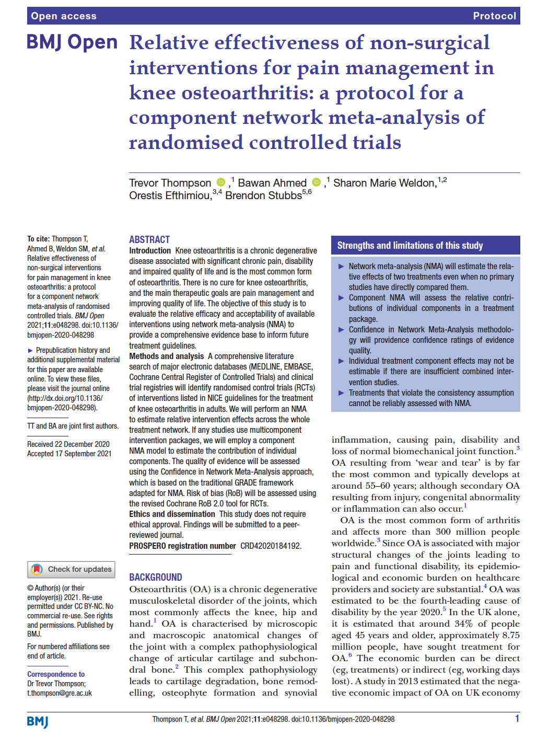
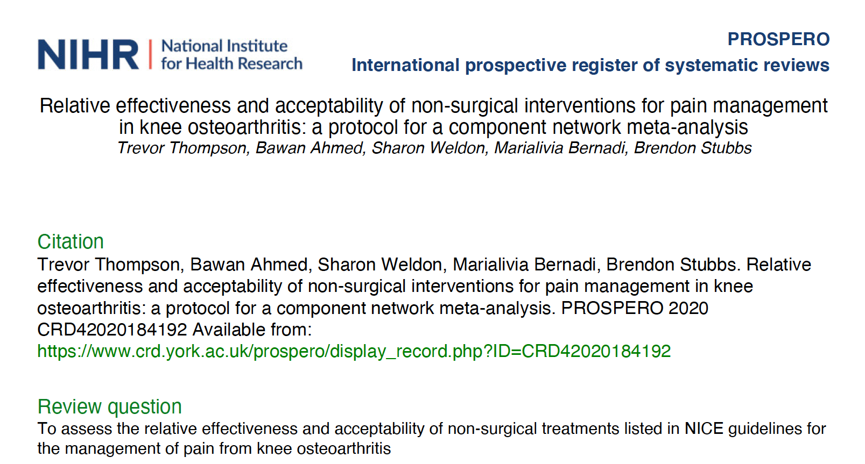

Slide 15
Rational: Pharmacotherapies are widely used in Knee OA management, however:
Long-lasting debate about their relative effectiveness and acceptability
Appropriateness of long-term use?
Lack of head-to-head trials for all competing interventions
Methods: SR, MA, NMA, CNMA
Aim: to find optimal intervention(s)
Outcomes
Pain
Stiffness
Function
Acceptability
Immediate
Short
Medium
Long

Slide 16
Databases MEDLINE, EMBASE, CENTRAL, and trial registries.
Population (P) Adults (≥18 years) with KNOA based on a clinical or radiographic diagnosis
Interventions (I) Oral Paracetamol Non-selective NSAIDs (Oral: with or without gastroprotection, Topical and Transdermal) COX2-inhibitors Oral and Transdermal Opioids Duloxetine Topical Capsaicin Intra-articular Hyaluronic acid (IAHA) Intra-articular Corticosteroids (IACS) | Comparison or Control (C) Another eligible active intervention or control (placebo, no treatment, or usual care)
Outcome: Pain (primary outcome) Assessed over: Immediate (up to two weeks), Short (closest to 3 months), Medium (closest to 6 months), Long (closest to 12 months)
Study type (S) Randomised Controlled Trials (RCTs)
Analyses A random-effects standard NMA and additive CNMA with placebo as a common comparator were used to estimate relative treatment effects for the primary outcome of pain within a frequentist framework. Effect size measure: Mean Differences (MD) as the change from baseline on rescaled 0-10 scale with 95% Confidence Interval (CI). |  | The certainty of evidence was evaluated using the Confidence in Network Meta-Analysis (CINeMA). The risk of bias (RoB) was assessed using the revised Cochrane RoB2 tool. The frequentist P-scores were employed for the treatment hierarchy. All analyses were conducted in R using the netemeta package.

Slide 17
Statistical considerations
Transitivity was assessed epidemiologically by visually inspecting the distribution of potential effect modifiers.
Publication/small-study bias were assessed using funnel plots and Egger’s test.
The heterogeneity/inconsistency :
𝑄 statistics and generalised I² statistics
A common estimate for the heterogeneity variance was assumed (𝜏²) using REML estimator.
The percentage of total variability due to between-study heterogeneity was statistically tested using the I² statistics.
Inconsistency (incoherence) :
Globally, using a full-design-by-treatment interaction and
Locally using the SIDE back-calculation method under the random effects model

Slide 18
Oral
Paracetamol
NSAIDs
Topical
Transdermal
Intra-Articular
COX2-i
Opioids
Duloxetine
NSAIDs
Capsaicin
NSAIDs
Opioids
Corticosteroids
(IACS)
Hyaluronic Acid (IAHA)
NSAIDs/gastroprotection

Slide 19
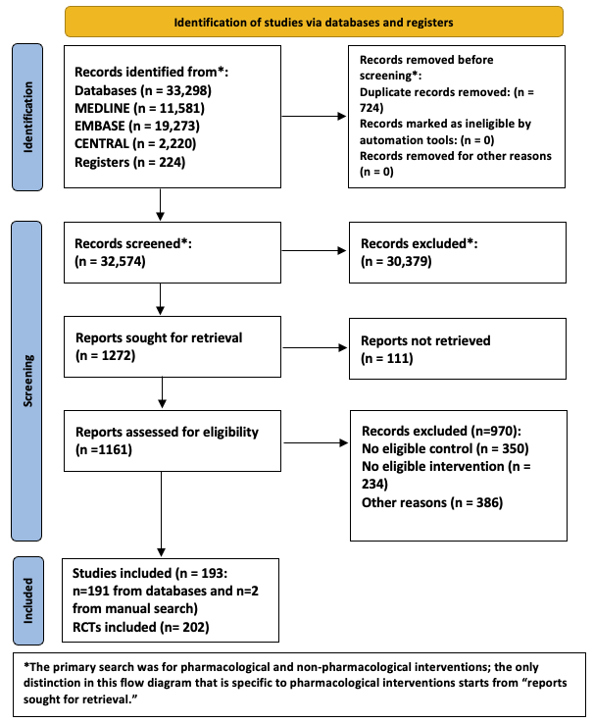
Fig.3. PRISMA flow diagram. Ahmed et al. (n.d.) manuscript in preparation

Slide 20
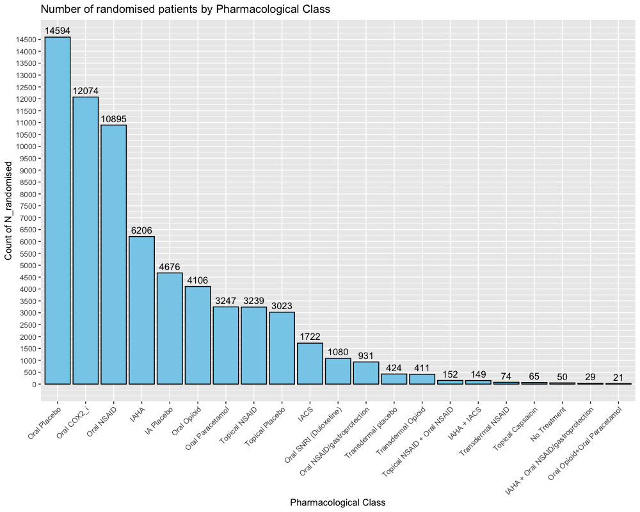
Fig.4. Number of randomised patients per intervention class. Ahmed et al. (n.d.) manuscript in preparation

Slide 21
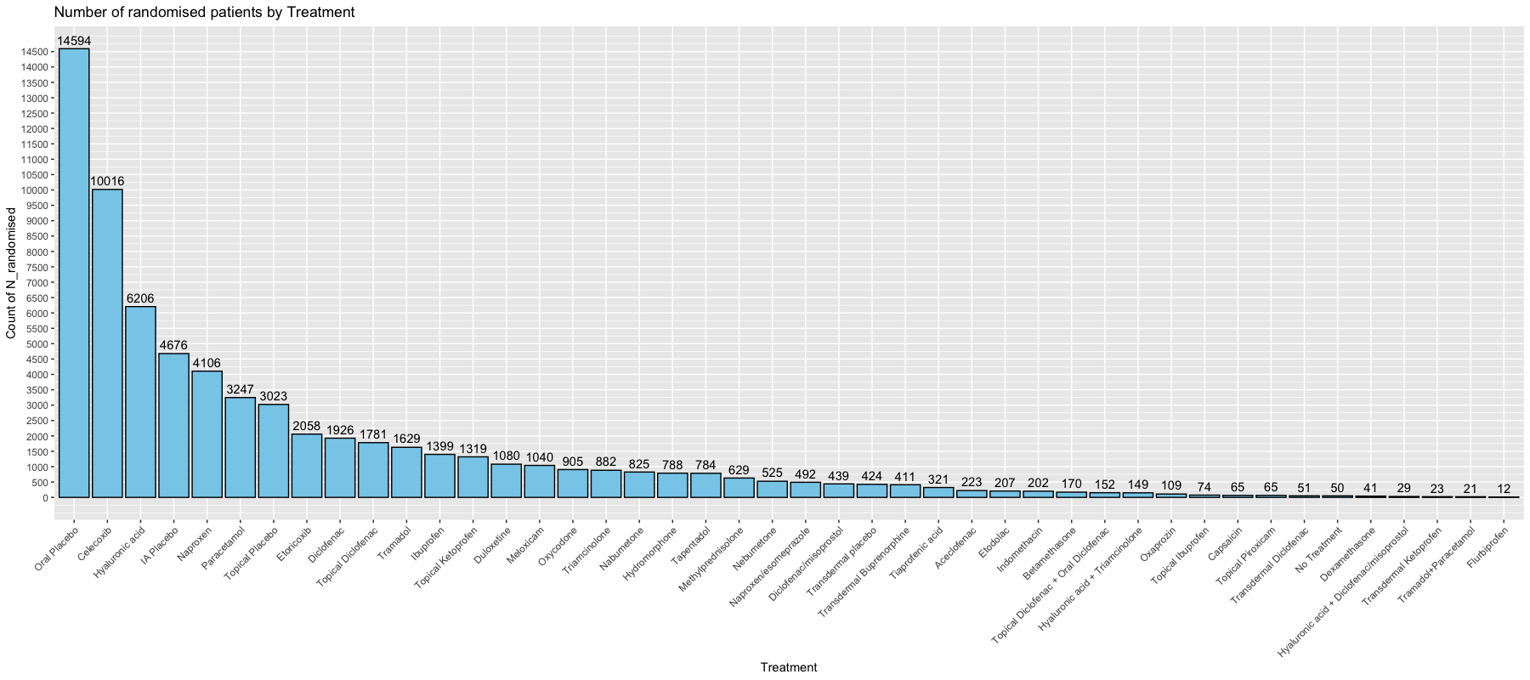
Fig.5. Number of randomised patients per individual treatments. Ahmed et al. (n.d.) manuscript in preparation

Slide 22
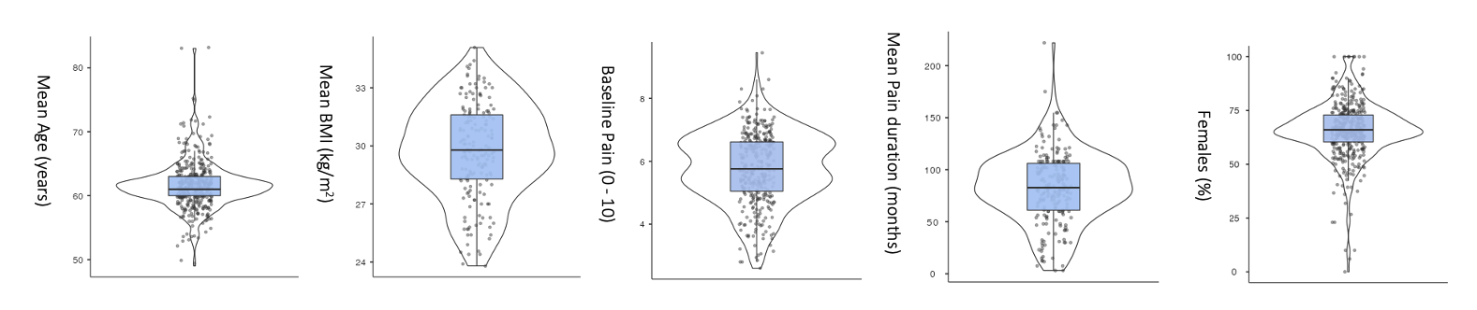
Fig.6. Violin jittered box plots for baseline characteristics of patients. Ahmed et al. (n.d.) manuscript in preparation

Slide 23
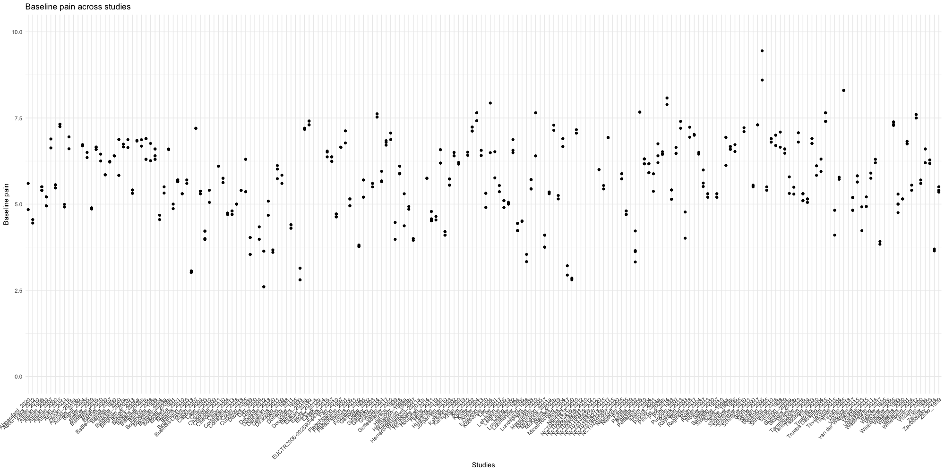
Fig.7. Distribution of baseline pain across studies. Ahmed et al. (n.d.) manuscript in preparation

Slide 24
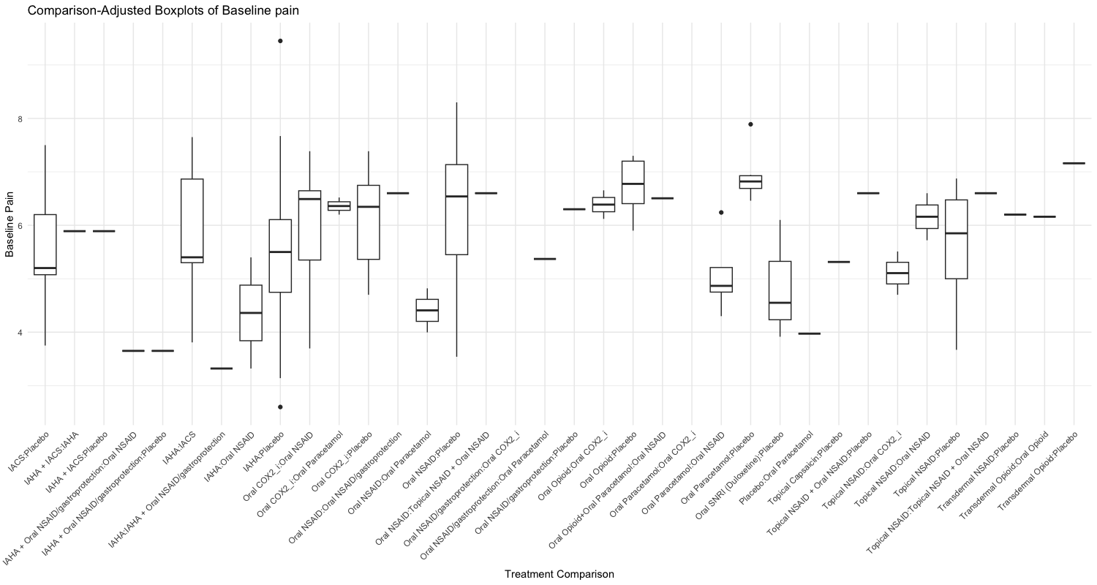
Fig.8. Comparison adjusted box plots for baseline pain. Ahmed et al. (n.d.) manuscript in preparation

Slide 25
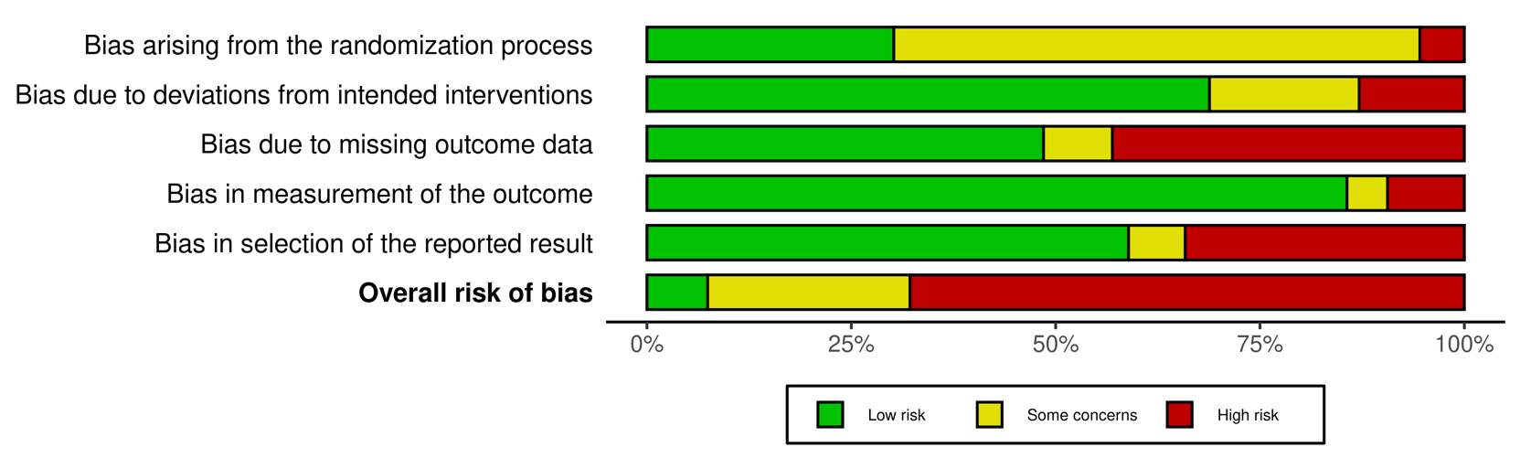
Pharmacological interventions risk of bias assessment Assignment to intervention (the 'intention-to-treat' effect) Total number of studies = 202
 | Randomization process | Deviations from intended interventions | Missing outcome data | Measurement of the outcome | Selection of the reported result | Overall Bias
Low risk (%) | 30.2 | 68.8 | 48.5 | 85.6 | 59.4 | 7.4
Some concerns (%) | 64.4 | 18.3 | 8.4 | 5 | 6.4 | 24.8
High risk (%) | 5.4 | 12.9 | 43.1 | 9.4 | 34.2 | 67.8
Fig.9. Summary of RoB2 assessment. Ahmed et al. (n.d.) manuscript in preparation

Slide 26
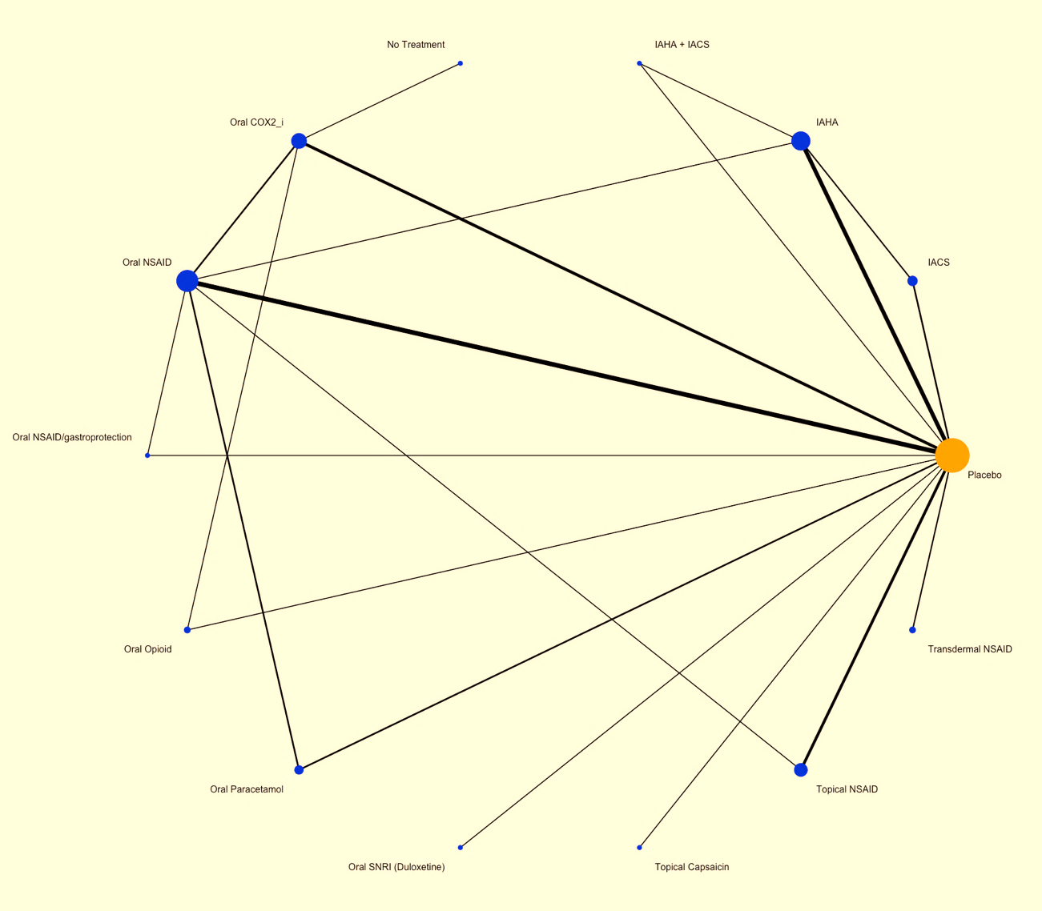
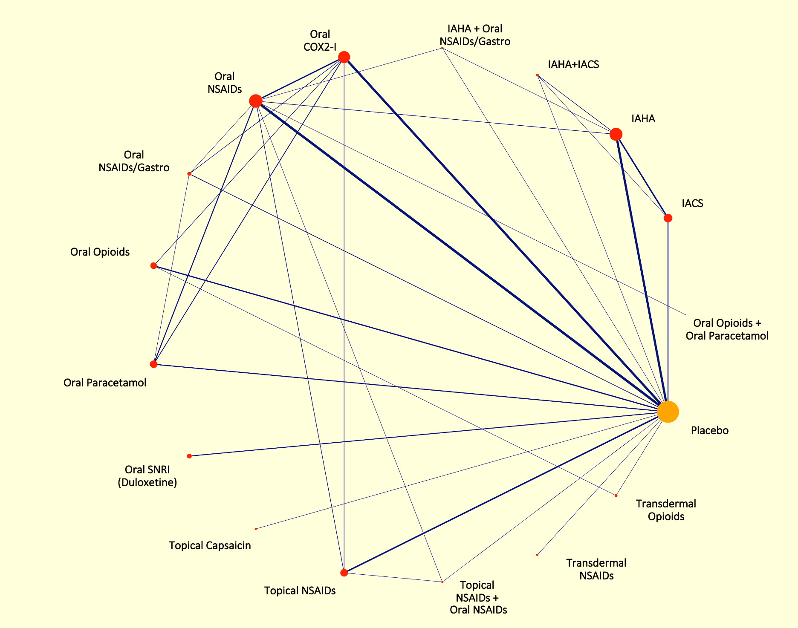
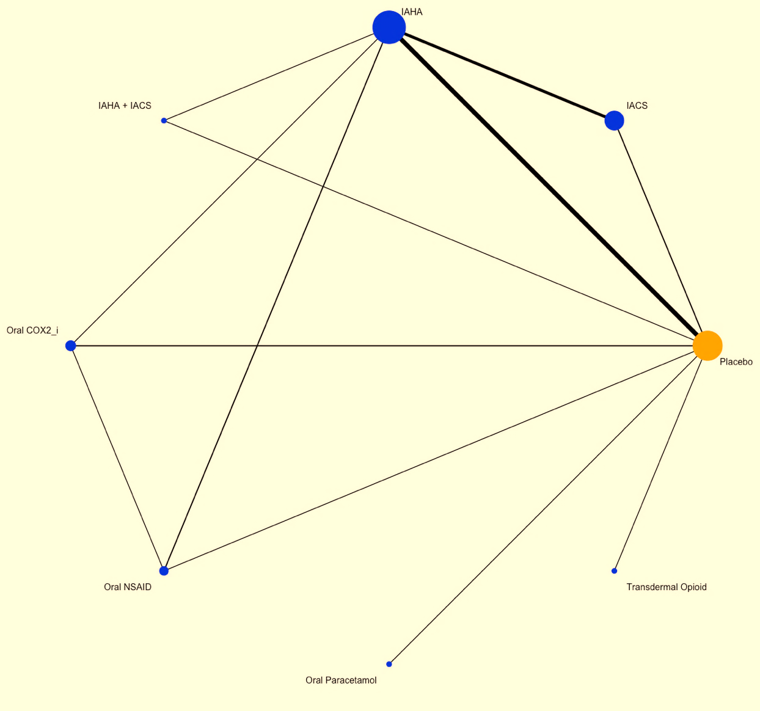
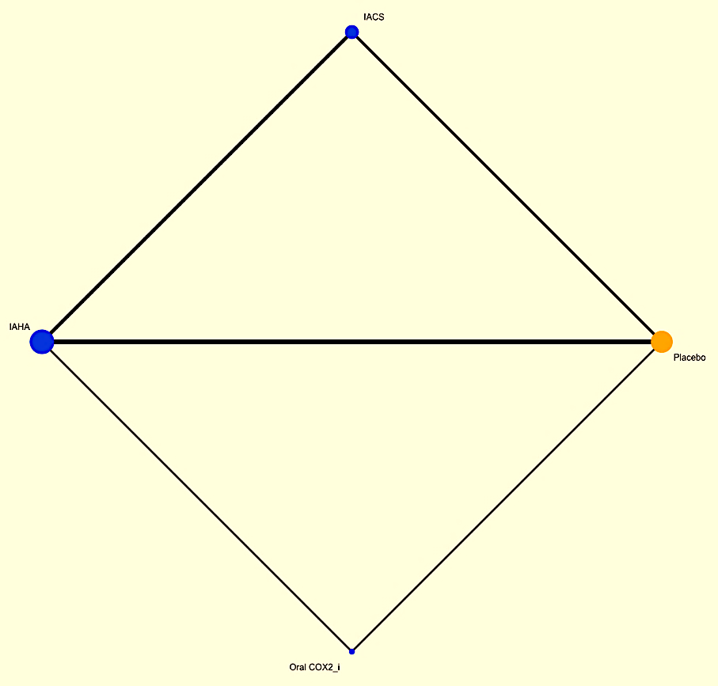
Network Diagrams of pharmacological interventions for pain. Ahmed et al. (n.d.) manuscript in preparation
Immediate-term (up to 2 weeks)
Short-term (closest to 3 months)
Medium-term (closest to 6 months)
Medium-term (closest to 12 months)

Slide 27
Fig.10. Network diagram, pain, short-term. Ahmed et al. (n.d.) manuscript in preparation

Slide 28
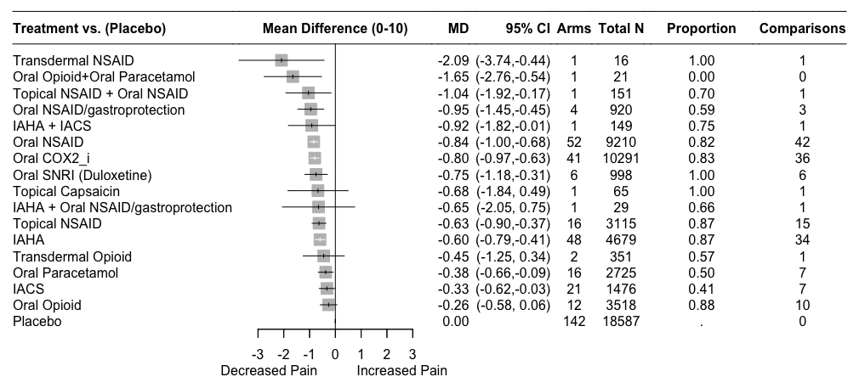
Fig.11. Standard NMA forest plot, short-term. Ahmed et al. (n.d.) manuscript in preparation

Slide 29
Fig.12. Standard NMA and additive CNMA forest plots, short-term. Ahmed et al. (n.d.) manuscript in preparation

Slide 30

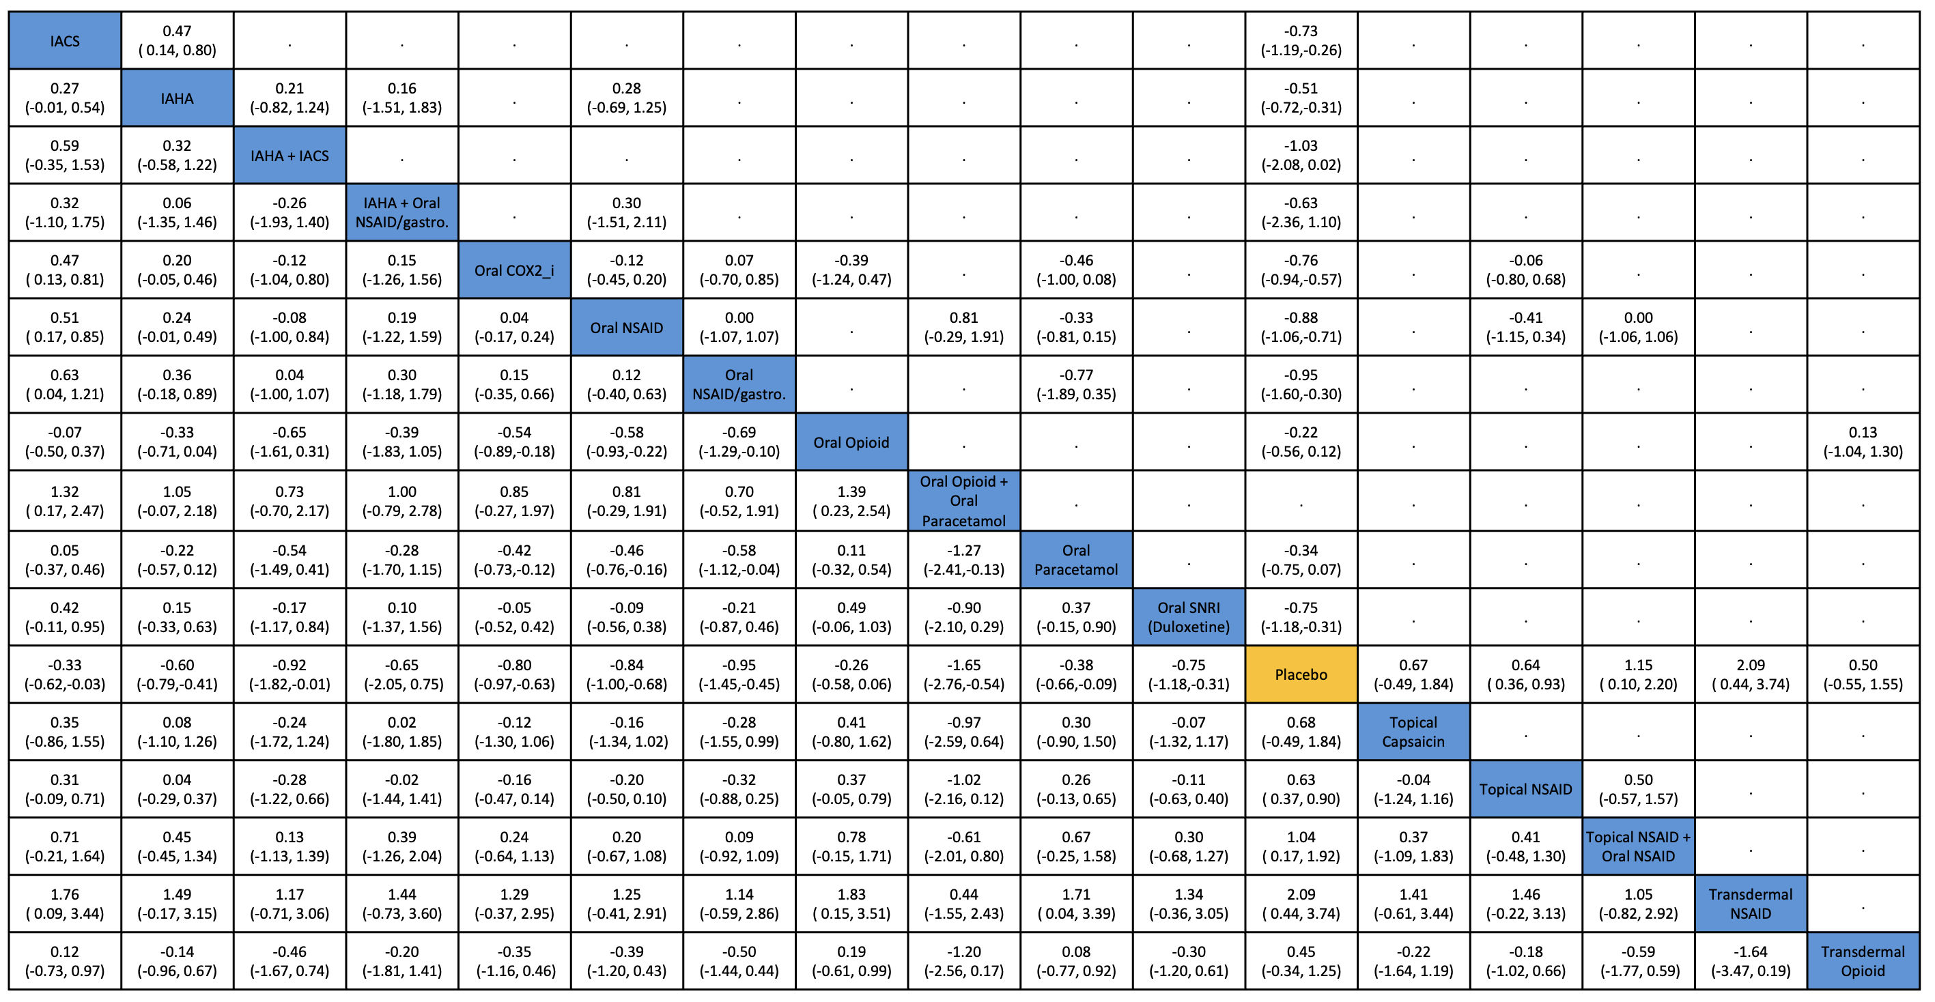
League table. Ahmed et al. (n.d.) manuscript in preparation

Slide 31
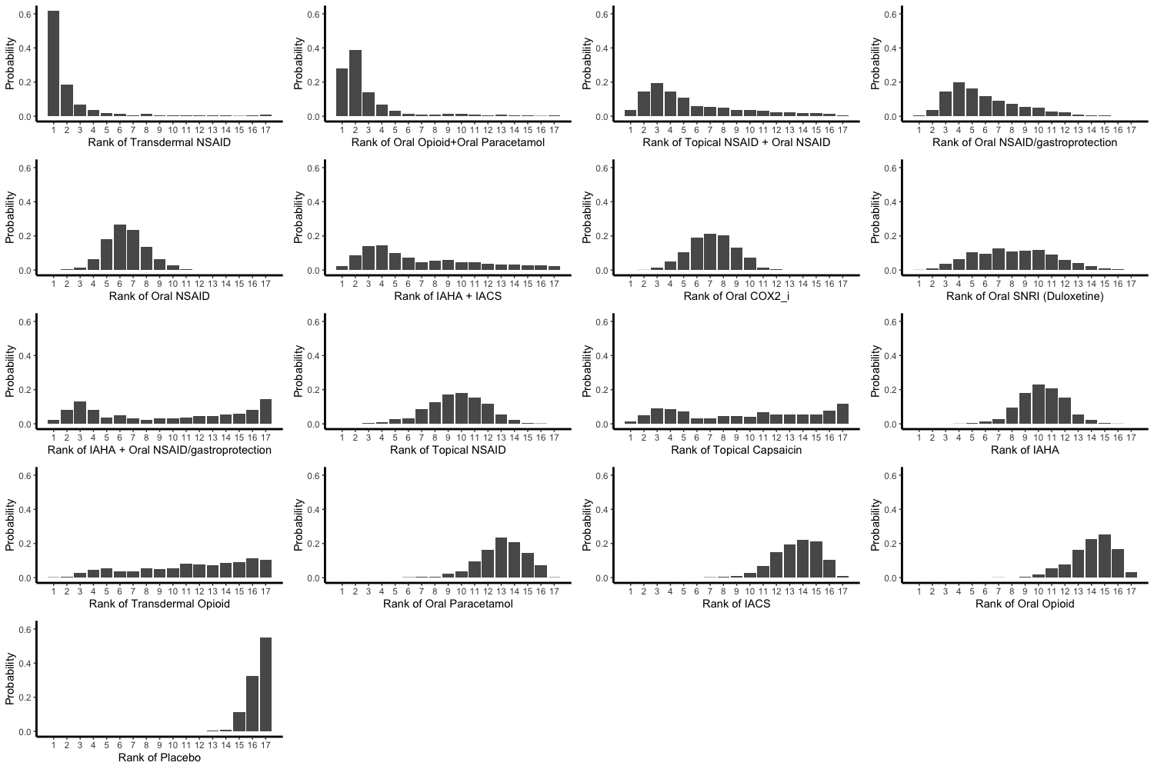

Slide 32
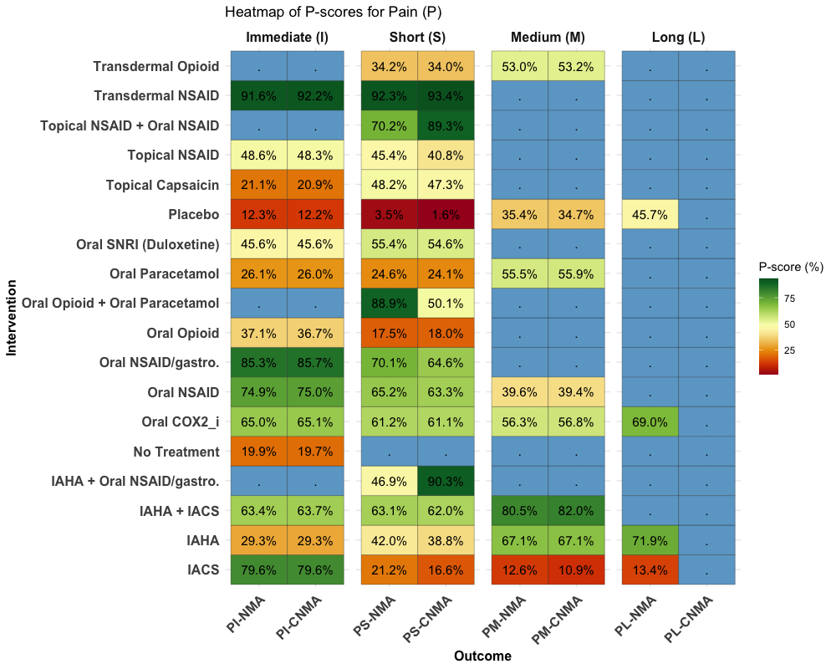

Slide 33
Conclusions
Several interventions were associated with significant analgesic effects in the immediate to short-term but fewer clinically meaningful effects.
Effect and sources of evidence diminished over time.
Overall, the comparative effectiveness of pharmacological interventions is less pronounced than suggested by individual RCTs.
High RoB dominated the methodological quality of Knee OA trials.
Evidence grading: Very Low to Moderate
Overall, findings support the use of Transdermal NSAIDs, topical NSAIDs, oral NSAIDs with or without gastroprotection, and oral COX2 inhibitors.
Findings do not support the use of opioids, duloxetine, viscosupplementations, IACS beyond two weeks, paracetamol, or topical capsaicin.

Slide 34
Implications for pharmacists:
Practice: Leveraging the role of Network meta-evidence synthesis to inform clinical decision-making
Research: From clinical research data -> evidence -> recommendations
Future directions:
Evidence synthesis using the employed methodology and dual-classification system in our research to synthesise evidence with consideration to individual treatments, different doses, dosing frequencies, and formulations
Trials for interventions that have not been compared before and more trials for interventions demonstrated potential to be the best intervention

Slide 35
Acknowledgements
The University of Greenwich Vice Chancellor Scholarship Fund.
Dr Trevor Thompson
Professor Sharon Weldon
Dr Damian Poulter
Dr Orestis Efthimiou
Dr Brendon Stubbs

